Slide 1
NAWI RO Analysis Progress Report
SGDC
W. Kumagai, H. Soya, R. Imoto
Operational Excellence Gr., Project Design Dev.,
Innovation Center, MKHQ, YHQ
August 30th, 2023

Slide 2
Agenda
RO Operation Optimization
RO Permeate Water Quality Prediction / Q&A
RO Optimization Simulation / Q&A
RO Membrane Scaling Modeling / Q&A
9:05 – 9:10
9:10 – 9:35
9:35 – 10:00
10:00 – 10:30
Notes:
This is today’s agenda. There are four parts, first part is RO Operation Optimization and Concept, second is RO Permeate Water Quality Prediction, third is Optimization Simulation, fourth is RO Membrane Scaling Modeling. We’ll have Q&A part at the end of second, third, fourth parts. If you have any questions, please save them until Q&A part.

Slide 3
Objective of RO Optimization
1. RO Operation Optimization
Chemical dosing costs are minimized considering RO membrane condition within the range of maintaining water quality and flow rate.
Maintaining high recovery rate, good water quality (high salt rejection), and extending RO membrane life.
Considering water quality, permeate flow rate, and RO clogging status.
Subject to be optimization target if interchangeable with RO.
Chemical costs
Chemical costs
Sulfuric Acid／Anti-Scalant
Membrane cleaning
UV Radiation with H₂O₂ or NaClO
NaClO
UF
RO
UV / AOP
Potable Water
Given Region
Water quality and flow rate to be maintained
Given Region
Degree of Clogging
Water quality
Clogging due to fouling Scaling by crystallization Bio-fouling by deposit
Membrane life
Notes:
First, I explain RO Operation Optimization. This shows potable water reuse process. Water from sewage plant is treated by this process and supplied to potable reuse. It mainly consists of UF, RO, UV, and AOP process units. The objective of RO optimization shows chemical dosing costs are ~. There are chemical costs in many places, for example, total chlorine, Sulfuric Acid, and anti-scalant. Moreover, there are considering conditions in many places, for example, recover rate, water quality, and RO clogging status. RO clogging is called bio-fouling or scaling. RO analytical policy is to expand the control and considered value step by step. First stage is to control and consider water quality and clogging.

Slide 4
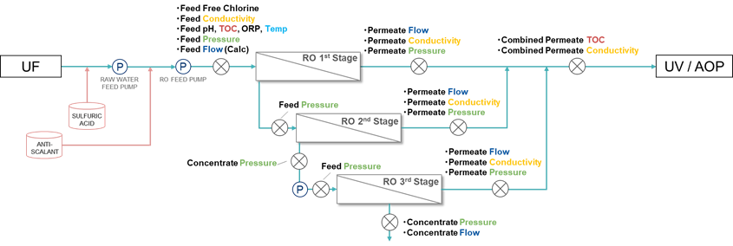
1. RO Operation Optimization
Overall view of LVMWD RO system
3 Stages configuration.
Water quality data is RO permeate TOC and Conductivity.
Monitoring LRV (logarithmic reduce value) as water-quality standards.
RO system
Water Quality Targets are shown in red.
measuring point
P
pump
Notes:
This shows Las Virgenes RO system. This is 3 stages configuration. Water quality data is RO permeate TOC and Conductivity. They are measured at each RO stage permeate point. Water-quality standards is monitored as LRV.

Slide 5
Desktop Evaluation Flow Chart
1. RO Operation Optimization
Plant Info. Check
Step1
Check the plant flow & data
Check the plant flow chart, control & manipulated variable, evaluation index, and data trends.
Decide optimization story and modeling way.
Model Construction
Step2
Construct and validate the plant model
Detailed in Section 2
Construct the plant model including water quality prediction models.
Especially prediction models are validated individually.
Optimization
Step3
Execute optimization simulation
Detailed in Section 3
Implement the optimization problem and optimizer.
Execute simulation and validate/check the behavior.
Effect Calculation
Step4
Calculate the optimization effect
Compare optimization results with operation actual data in the past.
Notes:
This is desktop evaluation flow chart in NAWI Project. Step1 is check plant information. We check the plant flow chart~. Step2 is model construction. We construct~. Step3 is optimization. We implement~. Step4 is effect calculation. We compare~. We’ll explain step2 in detailed in Section2 and step3 in Section3.

Slide 6
Agenda
RO Operation Optimization
RO Permeate Water Quality Prediction / Q&A
RO Optimization Simulation / Q&A
RO Membrane Scaling Modeling / Q&A
9:05 – 9:10
9:10 – 9:35
9:35 – 10:00
10:00 – 10:30

Slide 7
Agenda
2. RO Permeate Water Quality Prediction
2.1 Introduction: summary up to the previous meeting
Data Preprocessing, Prediction model
2.2 Prediction and Preprocessing Results
Prediction by Multiple Regression Model and Random Forest
Minor Manual Preprocessing for Permeate TOC Data
Notes:
I will talk about the part of water quality prediction.
I have talked twice before about our progress in predicting water quality of RO membranes.
Therefore, the main topic of this part is going to be about the new progress of water quality prediction.
Before starting my presentation let me review major point of my session for prediction results.
First item is pre-processing.
Up to previous presentation, preprocessed process was carried out manually.
To generalize preprocessing process, I tried applying systemic approach this time.
Next, I will show you the image of sequential prediction concept.

Slide 8
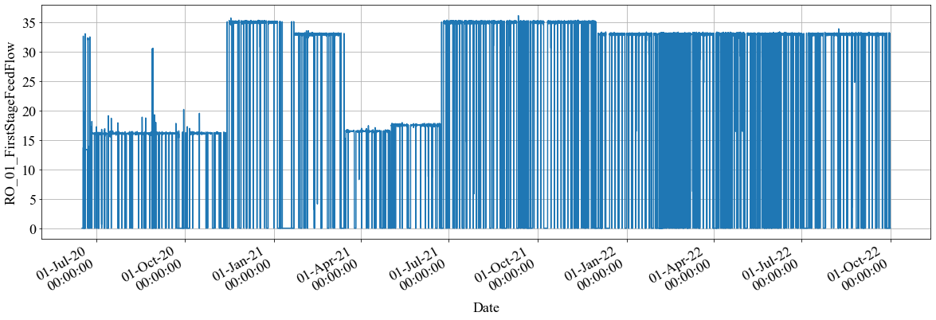
Data Preprocessing
2.1 RO Permeate Water Quality Prediction > Introduction
Creating “master data“ for analysis from raw dataset by pretreatment.
Step1: Filtering oriented by Plant Management
Getting rid of the data during the period as the following major rules.
Step2: Filtering based on Formular
“3σ Variance” or “Kalman Filter” is applied only when Step1 does not filter outliers enough.
Feed Flow Rate Raw Data (1minute span)
Local Rules in Step1
(1)
(2)
(3)
y=0
More than 10 min
Changing rate
More than 20%
Y
Y
Y
DATE
DATE
DATE
Value is 0
Constant value lasts long term
Changing Rate is high
Notes:
Now, here is the systematic pretreatment procedure we have performed.
It consists of two steps.
Step 1 is Filtering oriented by Plant Management.
This step is Getting rid of the data during the period when it is as following
The first is when First Feed Flow Rate equal 0.
In this case, there is no treated water coming to the Feed, so the system is considered to be stopped and needless to count.
The second is when the measurement value remains same value for more than 10 minutes.
Lasting with same value for a long time has a possibility that the measurement is not working properly.
The third is when Changing rate of measurement value is more than 20%.
If the measured values change drastically, there is a possibility that proper operation is not being performed.
They are thought of major typical inappropriate factors, other minor factors can be conformed in the previous presentation of Soya-san.
Basically, since outliers can be removed in Step 1, the process ends here.
However, if outliers could not be removed in Step 1, Step 2 applied.
In this way, all variables were pre-processed, and master data was created.

Slide 9
Sequential Prediction (1 week Training and 1 week Prediction)
2.1 RO Permeate Water Quality Prediction > Introduction
Training
Training
Training
Training
We
e
k 1
We
e
k 2
We
e
k 2
We
e
k 3
We
e
k 3
We
e
k 4
We
e
k 55
We
e
k 56
predict
predict
predict
・・・
predict
Prediction trend
We
e
k 2
We
e
k 3
We
e
k４
We
e
k 56
“Prediction trend” is totally compiled with each weekly prediction trend all through the period.
・・・
Notes:
Next, I share an image of sequential prediction.
In the method,
first week data used for learning and second data were evaluated.
Second week data used for learning and third data were evaluated.
This process continues to the last week.
Total prediction trend consists of each weekly evaluation unit.
Introduction is up to this slide.

Slide 10
Today’s Topic Agenda
2.2 RO Permeate Water Quality Prediction > Prediction and Preprocessing Results
Multiple Regression Model
Prediction results by Multiple Linear Regression for EC
Prediction results by Multiple Linear Regression for TOC
Impact of Preprocessing on Prediction
Impact of Data Disturbance on Prediction
Radom Forest（New Approach）
Prediction results by Multiple Linear Regression for EC
Prediction results by Multiple Linear Regression for TOC
Comparing MLR and Random Forest
Consideration : Characteristics of Random Forest
Extra Trial（systematically pre-processing with minor manual tuning）
Changing Pretreatment Parameters for Permeate TOC
Notes:
Then, let me move onto today’s presentation.
First, in Section A, I will show you the results with multiple linear regression used systematically pre-processed master data.
In B, I will introduce new approach applying random forest method to the prediction.
Finally, I will show the results of Extra Trial.

Slide 11
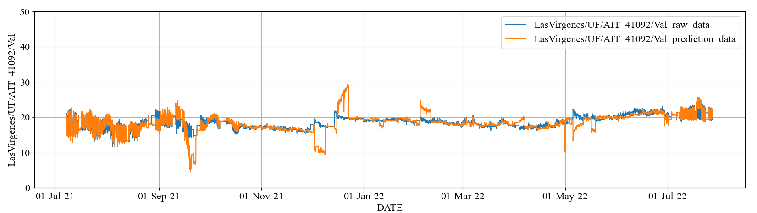
2.2 RO Permeate Water Quality Prediction > Prediction and Preprocessing Results by MLR
Prediction results by Multiple Linear Regression for EC
Stage1 Permeate EC [uS/cm]
Pre-processed actual data
Predicted data
Index | Stage1 Permeate EC
RMSE | 1.88 (uS/cm)
MAPE | 5.24 (%)
Notes:
First, I will start with the issue of multiple regression model for following four pages.
This slide shows Stage 1 Permeate conductivity prediction as a representative of Permeate conductivity.
The result of Stage 2 and 3 predictions are omitted, because these are similar to that of Stage1.
In the figure, there are two lines:
the blue line shows the pre-processed actual data, and the orange line shows the predicted data.
The RMSE and MAPE values are in the table under the figure.

Slide 12
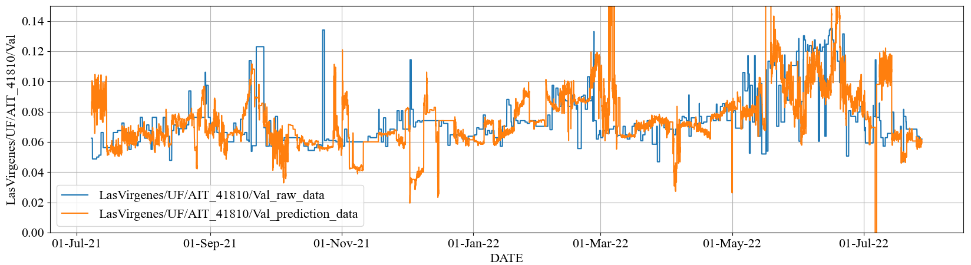
2.2 RO Permeate Water Quality Prediction > Prediction and Preprocessing Results by MLR
Prediction results by Multiple Linear Regression for TOC
Combined Permeate TOC [mg/L]
Pre-processed actual data
Predicted data
Index | Combined Permeate TOC
RMSE | 0.023* (mg/L)
MAPE | 18.46* (%)
Notes:
This slide is for Combined Permeate TOC.
Coloring condition of the line in figure is as same as that of previous slide.
And table structure is as same as that of previous slide, too.
The prediction accuracy by the systematic preprocessed protocol may be almost as same as the accuracy by manual preprocess, based on considering the results.
Systematic preprocessed protocol should be basically adopted prior to manual tuning, because it takes a lot of time and effort to apply manual tuning as long as prediction accuracy between the method is guarantee.

Slide 13
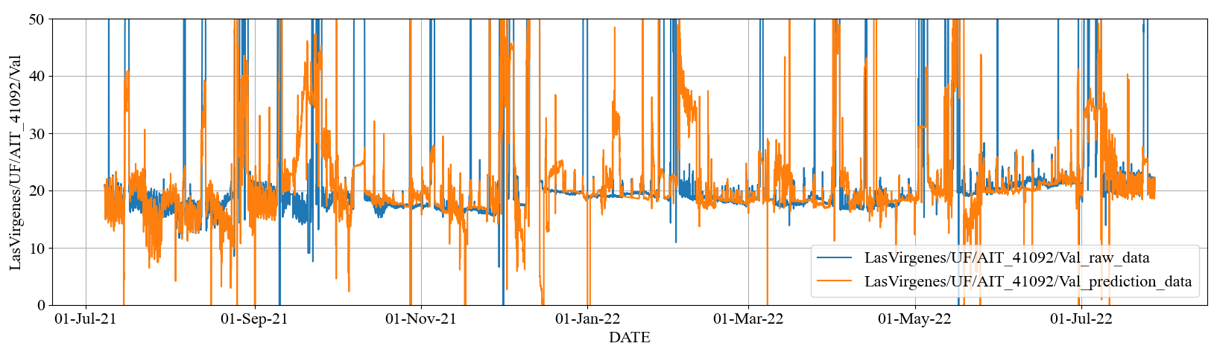
2.2 RO Permeate Water Quality Prediction > Prediction and Preprocessing Results by MLR
Impact of Preprocessing on Prediction
Stage1 Permeate EC [uS/cm]
preprocessing
Notes:
Please look at this slide, it is very useful for you to compare with and without pretreatment.
This comparison is the data of Stage 1 Permeate conductivity.
The upper Figure shows the result without pretreatment, and the lower Figure shows the result with systematic preprocessing.
You can easily find out the main point is the difference of orange line between 2 figures.
The orange line in the lower figure is stable.
On the other hand, that in the upper figure is largely fluctuating.
In this way, we can make out the importance of pretreatment.

Slide 14
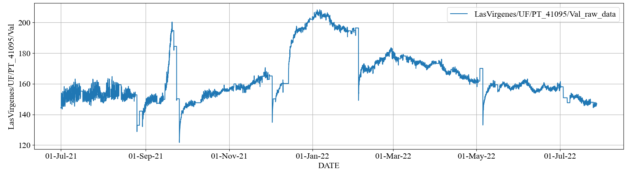
2.2 RO Permeate Water Quality Prediction > Prediction and Preprocessing Results by MLR
Impact of Data Disturbance on Prediction
①
②
③
④
⑤
Target ① Stage1 Permeate EC
①
②
③
④
⑤
Feed Pressure
Notes:
Roughly speaking, we can succeed in good prediction by systematic preprocessing, but it remains several points to be treated.
Therefor we picked up the points and analyzed the feature.
Upper figure has been introduced the prediction result of Stage 1 Permeate conductivity, slide 12.
In the figure, we can see the 5 typical periods is colored in red.
Please look at lower figure.
The figure indicates Feed pressure trend and large fluctuate are observed at the same timing as above figure.
Feed Pressure is one of the explanatory variables used in the prediction.
So, large error may be derived from the fluctuation of Feed pressure.
The CIP event was carried out during the periods except period ③.
The membrane was cleaned up by the events and the load of Feed Pressure decried.
There is the possibility to take several periods to be stabilized performance after CIP.
By the effect of this, the Feed Pressure trends may be large fluctuation.
This issue should come from larger fluctuation of explanatory variable in the linear regression.
Linear regression has tendency to large the fluctuation value basically depending on the increase of explanatory variable.
It is sort to be difficult predicting these periods with Multiple Linear Regression.
Let me move on next topic.

Slide 15
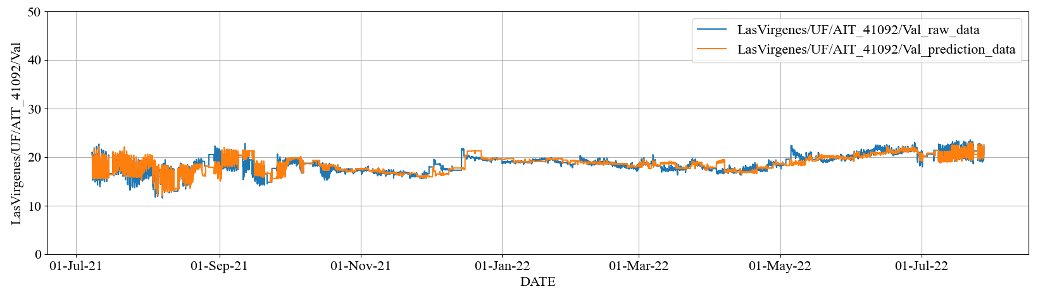
2.2 RO Permeate Water Quality Prediction > Prediction and Preprocessing Results by Random Forest
Prediction results by Random Forest for EC
Stage1 Permeate EC [uS/cm]
Pre-processed actual data
Predicted data
Index | Stage1 Permeate EC
RMSE | 0.88 (uS/cm)
MAPE | 3.20 (%)
Notes:
I will introduce the new approach: random forest in place of Multiple Linear Regression.
This slide shows Stage 1 Permeate conductivity prediction as a representative of Permeate conductivity.
The result of Stage 2 and 3 predictions are omitted, because these are similar to that of Stage1.
In the figure, there are two lines:
the blue line shows the pre-processed actual data, and the orange line shows the predicted data.
The RMSE and MAPE values are in the table under the figure.

Slide 16
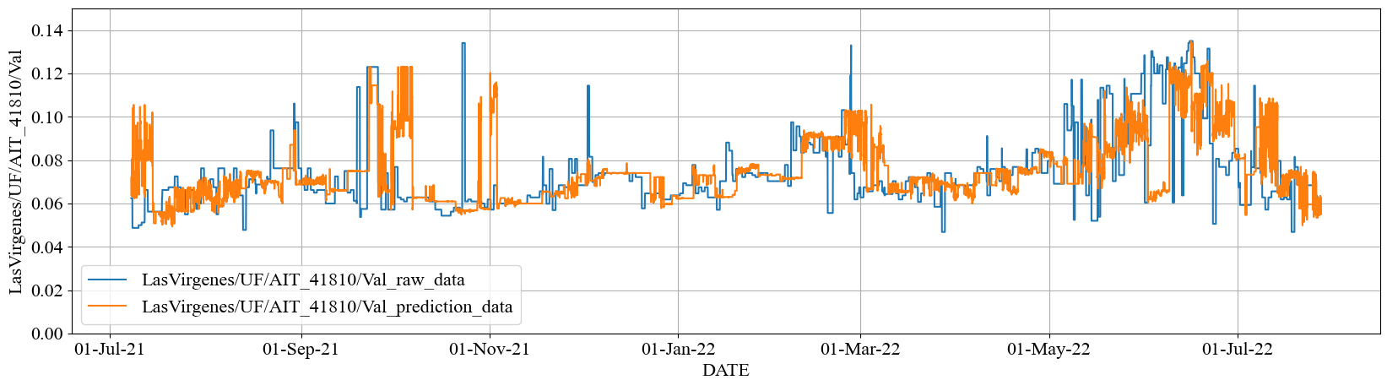
2.2 RO Permeate Water Quality Prediction > Prediction and Preprocessing Results by Random Forest
Prediction results by Random Forest for TOC
Combined Permeate TOC [mg/L]
Pre-processed actual data
Predicted data
Index | Combined Permeate TOC
RMSE | 0.017 (mg/L)
MAPE | 15.02 (%)
Notes:
This slide is for Combined Permeate TOC.
Coloring condition of the line in figure is as same as that of previous slide.
And table structure is as same as that of previous slide, too.

Slide 17
2.2 RO Permeate Water Quality Prediction > Prediction and Preprocessing Results
Comparing MLR and Random Forest
Stage1 Permeate EC [uS/cm]
①
②
③
④
⑤
Multiple Regression Model
①
②
③
④
⑤
Radom Forest
Notes:
Please look at this slide, it is very useful for you to compare Multiple Linear Regression and Random Forest.
This comparison is the data of Stage 1 Permeate conductivity.
The upper Figure shows the result with Multiple Linear Regression, and the lower Figure shows the result with Random Forest.
You can easily find out the main point is the difference of orange line in blue periods between 2 figures.
These blue periods almost overlap the periods colored red of slide15.
The orange line in the lower figure is stable.
As I mentioned the colored red is not good at prediction with Multiple Linear Regression.
Therefore, that in the upper figure is large error.
This difference should come from the feature between Multiple Linear Regression and Random Forest.
I would like to introduce the different characteristics between two methods.

Slide 18
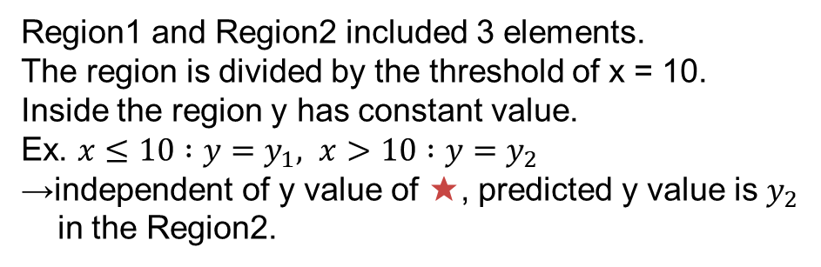
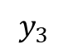
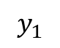
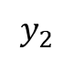
2.2 RO Permeate Water Quality Prediction > Prediction and Preprocessing Results
Consideration: Characteristics of Random Forest
Example: different impact of outlier depending on Models
Radom Forest Model
Linear Model
y
y
★
Outlier
Learned model
★
Outlier
Learned model
$$y_{3}$$
Region１
Region2
Random forest Model is more stable to outliers
$$y_{2}$$
★
★
$$y_{1}$$
10
x
x
Region1 and Region2 included 3 elements.
The region is divided by the threshold of x = 10.
Inside the region y has constant value.
Ex. $x≤10 :y=y_{1}, x>10 :y=y_{2}$
→independent of y value of ★, predicted y value is $y_{2}$
in the Region2.
The predicted y value depends on x value of ★.
→The predicted y value is y3 in the proportion of x value of ★.
Notes:
The slide shows an image of the difference in the impact of predictions on outliers between two methods.
The left figure shows an image of calculating prediction value with the random forest.
Main calculation algorithm is giving prediction value as average of each region.
In the figure, two different prediction value are given as same as average value.
The right figure shows an image of calculating prediction value with Linear Regression.
Prediction value is linearly given.
As 2 figures indicate Random Forest method gives more smaller error value than Linear Regression method when outlier of explanatory value is large.
Therefore, there might be the possibility for random forest model resolves the weakness point of linear regression method.

Slide 19
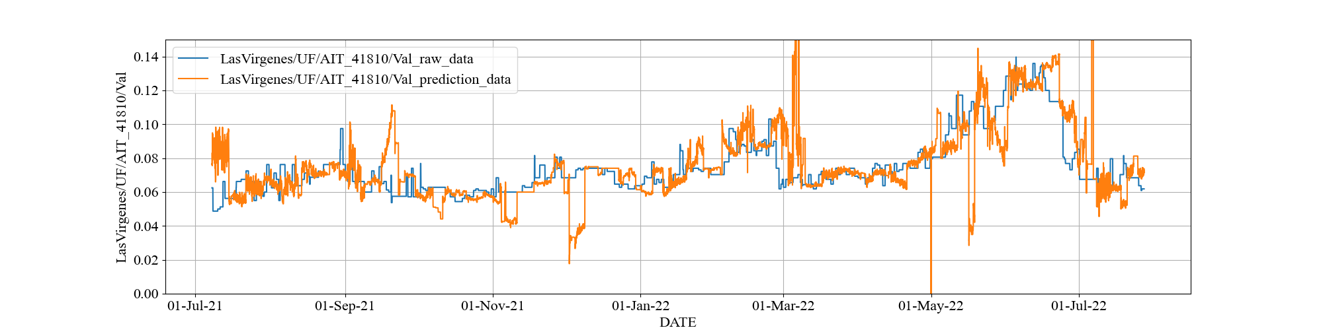
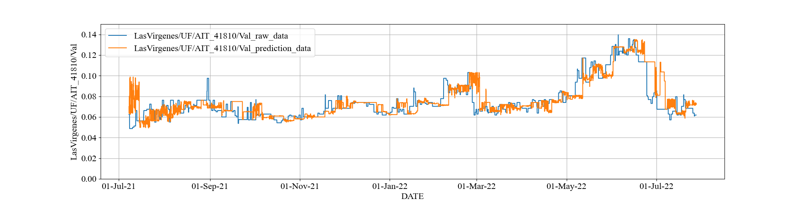
2.2 RO Permeate Water Quality Prediction > Minor Manual Preprocessing
Changing Pretreatment Parameters for Permeate TOC
Minor manual tuning is effective to minimize the error value. But tuning performance is highly influence of artifact.
Combined Permeate TOC [mg/L]
Multiple Regression Model
Radom Forest
Before
minor manual tuning
minor manual tuning
After
Notes:
Finally, I’ll show you the exploring extra trial.
Different from Permeate Conductivity prediction, there is some room to be improved to in the prediction of Permeate TOC.
This slide shows prediction of Permeate TOC with Multiple Linear Regression and Random Forest.
Upper left figure is the prediction with Multiple Linear Regression.
Upper right figure is the prediction with Random Forest.
Lower left figure is the prediction added on minor manual tuning with Multiple Linear Regression.
Lower right figure is the prediction added on minor manual tuning with Random Forest.
This result shows that added on minor manual tuning could improve predictions.
The last, but not least we must take care of the character of manual tuning.
In another word, generally speaking, manual tuning has a character to optimize the particular cases.
Therefore, this optimization can not necessarily apply as a case.
There are several difficulties to make use of each manual tuning into systematic treatment.
That's all for my part.

Slide 20
Agenda
RO Operation Optimization
RO Permeate Water Quality Prediction / Q&A
RO Optimization Simulation / Q&A
RO Membrane Scaling Modeling / Q&A
9:05 – 9:10
9:10 – 9:35
9:35 – 10:00
10:00 – 10:30
Notes:
Third part is optimization simulation. (9:35-9:50)

Slide 21
Summary
3. RO Optimization Simulation
Develop the RO optimization simulator with new optimizer built in, not based on DDMO.
It assumes that Yokogawa engineer can use it. But it has not yet been fully tested.
It needs more functions for pilot/demo-scale implementation.
Estimate the optimization effect comparing operational cost.
Notes:
My task is to develop~. After that, I estimated the~.

Slide 22
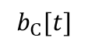
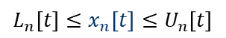
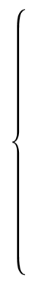
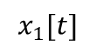
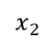
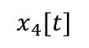
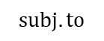
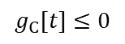
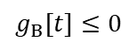
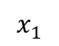
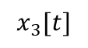
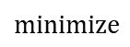
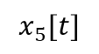
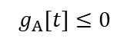
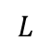
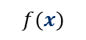
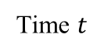
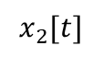
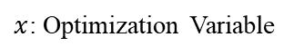
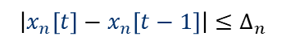
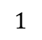
Plant Scheduling Optimization
3. RO Optimization Simulation > Simulator
1. Drawing Flow Chart
2. Formulation
Optimization Problem
3. Calculation
Operational Schedule
RO optimization problem is formulated into a scheduling optimization.
The procedure consists of the following steps.
Sample Flow Chart
$$minimize$$
$$f(x)$$
(Operational Cost)
$$subj.to$$
$$x_{1}$$
$$x_{1}[t]$$
A
$$x_{3}[t]$$
$$L_{n}\left[t\right]≤x_{n}\left[t\right]≤U_{n}\left[t\right]$$
$$x_{5}[t]$$
C
$$b_{C}[t]$$
$$\left|x_{n}\left[t\right]−x_{n}\left[t−1\right]\right|≤∆_{n}$$
$$x_{2}$$
B
$$x_{4}[t]$$
$$x_{2}[t]$$
$$g_{A}[t]≤0$$
$$g_{B}[t]≤0$$
(Facility Characteristics)
$$1$$
Time $t$
$$L$$
Facility Model
$x$: Optimization Variable
$$g_{C}[t]≤0$$
Operational Cost is $XX.
Notes:
RO optimization problem~. The procedure~. First step is drawing flow chart. In this chart, arrows connecting objects are assigned optimization variables. The object plays the role of exogenous variable, mathematical model, and predictive variable. Second step is formulation optimization problem. I define the minimizing the objective function and the constraints. Third step is calculation operational schedule. I solve the formulated problem using optimization algorithm.

Slide 23
Functional Configuration of RO Optimization Simulator
3. RO Optimization Simulation > Simulator
Pre-processing
Unify the file format, e.g., add calculated tag and up/down resampling according to given timespan based on master data without outliers.
Generate Model and Params
Generate optimization / prediction model files with user-specified modeling and parameter files using data in the training / optimization period.
Model Validation
Calculate prediction model error by input optimization variables fixed to actual value into optimization model, i.e., predict validation.
Optimize
Post-processing
Solve the RO plant scheduling problem by optimizer.
Calculate each average value and LRV of water quality, and draw each variable trend chart including LRV.
Notes:
This shows functional configuration of RO optimization simulator. Step1 is data preprocessing. Step2 generates model and parameters including prediction model files. Step3 is model validation. this calculates prediction model error by input~. Step4 solves the RO plant~. Step5 calculates each~.

Slide 24
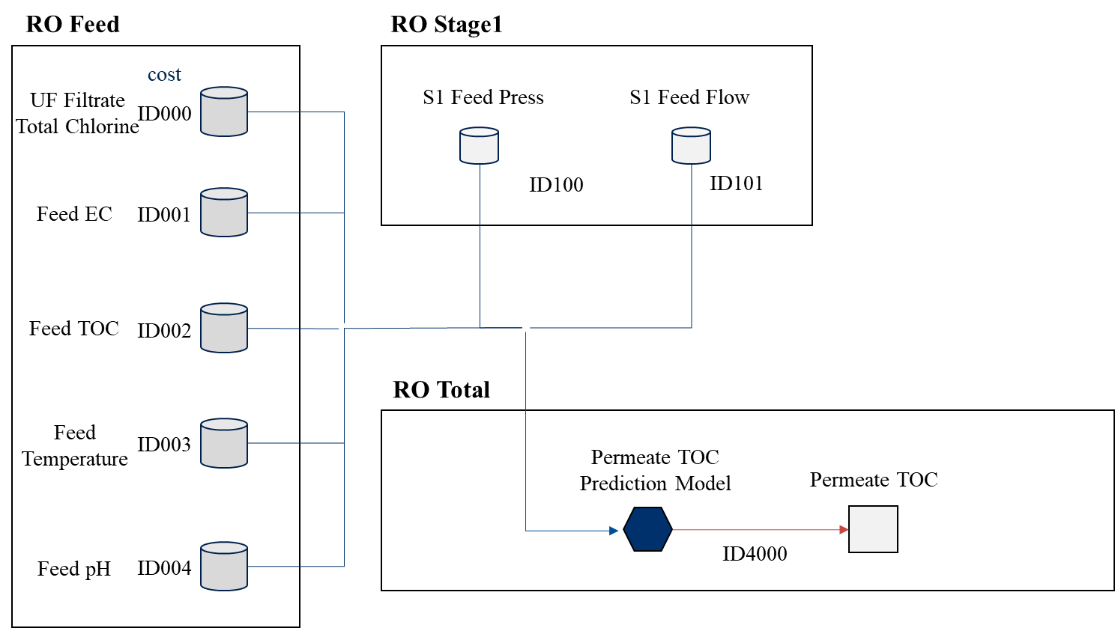
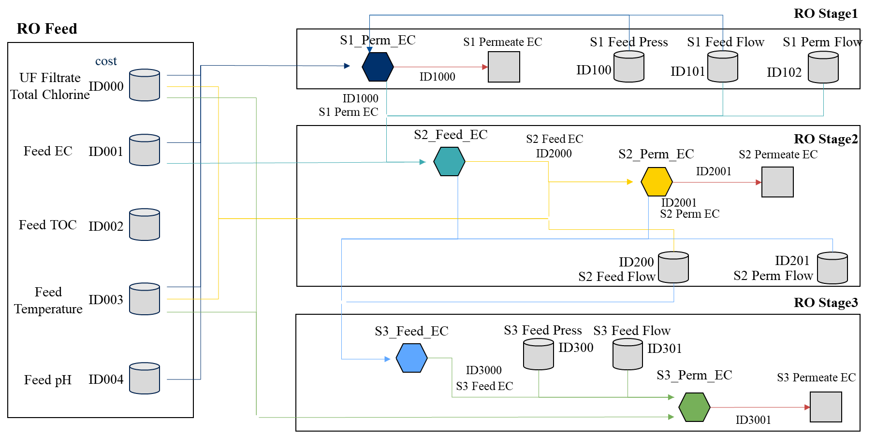
Flow Chart for RO Optimization
3. RO Optimization Simulation > Problem Formulation
We define the flow chart, variables, mathematical models.
The model dose not yet include RO Membrane Scaling / Fouling model.
RO Whole Part
RO Each Stage Part
Predictive Variable
(water quality)
Mathematical Model
(prediction model)
Exogenous Variable
Notes:
This is the flow chart for Las Virgenes model. I divided into the RO whole part and RO each stage part. The storage, the square, and hexagon object are exogenous, predictive variable that is water quality, and mathematical model including prediction model based on multi regression model. The arrow toward the object is input variable and the arrow from the object is output variable. But the model dose not yet include RO membrane scaling or fouling model.

Slide 25
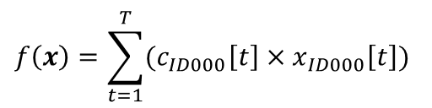
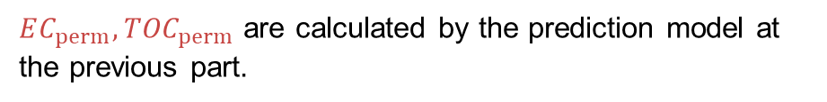
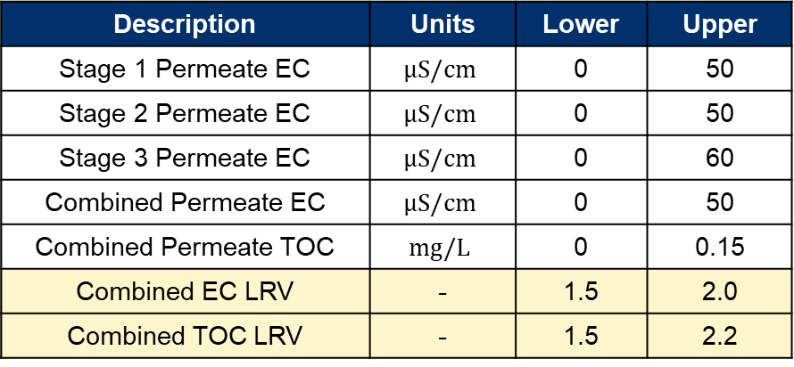
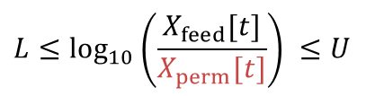
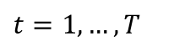
Optimization Problem
3. RO Optimization Simulation > Problem Formulation
Minimizing chemical cost while satisfying water quality standards.
Total Steps
$$f\left(x\right)=\sum_{t=1}^{T}{(c_{ID000}\left[t\right]×x_{ID000}\left[t\right])}$$
Objective Function
Unit Cost
UF Filtrate Total Chlorine
Main Constraint Conditions
Water Quality Standards and Upper / Lower limit
Logarithmic Reduction Value (LRV):
Description | Units | Lower | Upper
Stage 1 Permeate EC | $$μS/cm$$ | 0 | 50
Stage 2 Permeate EC | $$μS/cm$$ | 0 | 50
Stage 3 Permeate EC | $$μS/cm$$ | 0 | 60
Combined Permeate EC | $$μS/cm$$ | 0 | 50
Combined Permeate TOC | $$mg/L$$ | 0 | 0.15
Combined EC LRV | - | 1.5 | 2.0
Combined TOC LRV | - | 1.5 | 2.2
$$L≤\log_{10}\left(\frac{X_{feed}[t]}{X_{perm}[t]}\right) ≤U$$
$$t=1,…,T$$
$EC_{perm}, {TOC}_{perm}$ are calculated by the prediction model at the previous part.
Notes:
In this case, the optimization problem is minimizing the chemical dosing cost while satisfying water quality standards. The objective function f is formulated as the sum of the UF filtrate total chlorine of the optimization period. The main constraint conditions is water quality standards and upper or lower limit. This table shows each upper and lower limit about permeate EC and TOC. Especially, the EC LRV’s range is from 1.5 to 2.0, and TOC LRV’s range is from 1.5 to 2.2 in Las Virgenes plant. Moreover, the permeate quality values are calculated by the prediction model at the previous part.

Slide 26
Optimization Algorithm
3. RO Optimization Simulation > Optimizer
We must select the optimization algorithm the problem class.
This problem class can be nonlinear or black-box continuous optimization in future efforts of modeling.
Therefore, we use the combined algorithm with some known metaheuristic algorithms.
I wrote the python code from scratch and introduced into the optimization simulator.
Notes:
Next, I talk about optimization algorithm. We must select~.

Slide 27
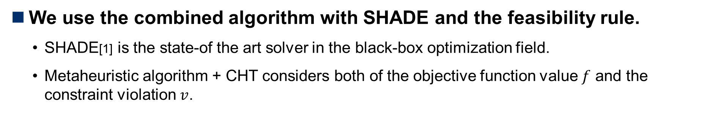
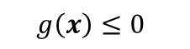
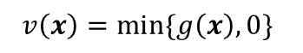
Metaheuristic Algorithm
3. RO Optimization Simulation > Optimizer
We use the combined algorithm with SHADE and the feasibility rule.
SHADE[1] is the state-of the art solver in the black-box optimization field.
Metaheuristic algorithm + CHT considers both of the objective function value $f$ and the constraint violation $v$.
Constraints:
$$g\left(x\right)≤0$$
Amount of Constraint Violation:
$$v\left(x\right)=\min{\{g\left(x\right), 0\}}$$
Unconstrained Prob.
Constrained Prob.
Metaheuristics Algorithm
SHADE, GA etc.
SHADE, GA etc.
+
Constraint Handling Techniques (CHTs)
Feasibility Rule, Static Penalty etc.
None
[1] R. Tanabe et al.: “Success-History Based Parameter Adaptation for Differential Evolution” (2013)
Notes:
We use the~. They are metaheuristic algorithm which is optimization solver for unconstrained nonlinear and Black-box optimization classes as well as Genetic Algorithm. SHADE is~. Constraint Handling Techniques can enable them to consider constraints. This is called CHTs. So, metaheuristic algorithm and CHT considers both of the~. Amount of constraints violation v is calculated by constraint function g.

Slide 28
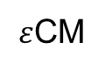
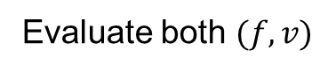
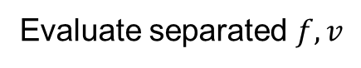
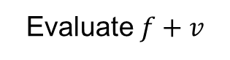
Constraint Handling Techniques
3. RO Optimization Simulation > Optimizer
CHT is divided into 3 classes[2].
Penalty-based CHT
Separatist-based CHT
Multi-objective-based CHT
Method
Evaluate $f+v$
Evaluate separated $f,v$
Evaluate both $(f,v)$
Search Efficiency of Trade-off Region
Low
Middle
High
Computational Complexity
Low
Low
High
Switching
Ranking
Pareto Ranking
Decomposition
Example
Death Penalty,
Feasibility Rule,
MCR
Two-Phase Framework
Adaptive MOEA/D
Adaptive Penalty
$ε$CM
[2] W. Kumagai and K. Yasuda: “Black-Box Optimization and Its Applications,” Innovative Systems Approach for Facilitating Smarter World, Springer Nature Singapore (2023)
Notes:
In this case, the optimization problem is minimizing the chemical dosing cost while satisfying water quality standards. The objective function f is formulated as the sum of the UF filtrate total chlorine of the optimization period. The main constraint conditions is water quality standards and upper or lower limit. This table shows each upper and lower limit about permeate EC and TOC. Especially, RO process operators monitor the logarithmic reduction value called LRV as standards. The LRV’s upper of EC is 2.5 and LRV’s upper of TOC is 2.0 in Las Virgenes plant. Moreover, the permeate quality values are calculated by the prediction model at the previous part.

Slide 29
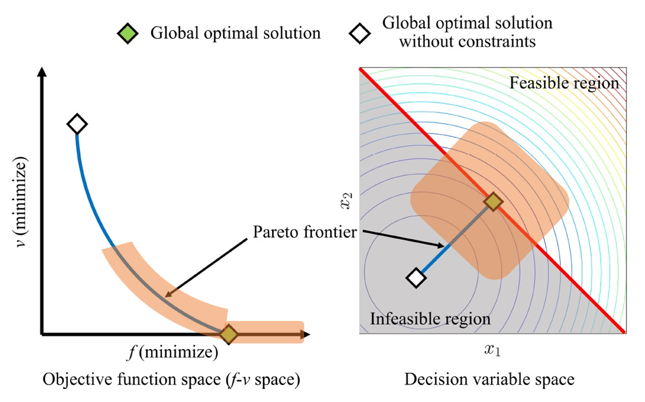




Concept of Feasibility Rule
3. RO Optimization Simulation > Optimizer
Select a solution putting $v$ before $f$.
Selection pressure for the feasible region is STRONG.
If two solutions $x,y$ are compared, use the following rule:
# | Compared | Select
1. | Violated solutions | Lower $v$
2. | Feasible and violated solutions | Feasible solution
3. | Feasible solutions | Lower $f$
Population
1st Step
2nd Step
$f:$Objective Function Value
$v:$Constraint Violation
Notes:
In this case, the optimization problem is minimizing the chemical dosing cost while satisfying water quality standards. The objective function f is formulated as the sum of the UF filtrate total chlorine of the optimization period. The main constraint conditions is water quality standards and upper or lower limit. This table shows each upper and lower limit about permeate EC and TOC. Especially, RO process operators monitor the logarithmic reduction value called LRV as standards. The LRV’s upper of EC is 2.5 and LRV’s upper of TOC is 2.0 in Las Virgenes plant. Moreover, the permeate quality values are calculated by the prediction model at the previous part.

Slide 30




Permeate Water Quality
3. RO Optimization Simulation > Prediction Result
Training Period: from March 7th to 14th, 2022 (1week)
Optimization Period : from March 14th to 21th, 2022 (1week)
Data Interval: 1hour
Blue: Actual / Orange: Prediction
The prediction performance for global trends is good.
Combined Permeate TOC [mg/L]
Combined Permeate EC [uS/cm]
Actual Ave.: 0.067 [mg/L],
Predict Ave.: 0.064 [mg/L]
Actual Ave.: 20.76 [uS/cm],
Predict Ave.: 20.87 [uS/cm]
Actual Ave.: 1.83,
Predict Ave.: 1.83
Actual Ave.: 2.01,
Predict Ave.: 2.03
*The results are NOT optimized when input data is fixed to actual data.
Notes:
Next, I talk about prediction and optimization results. This shows prediction results by simulator. Scheduling period is 1week and data interval is 1hour. left figure is combined permeate TOC and right figure is combined permeate Conductivity. Lower figures are LRV of TOC and EC. Blue line is actual data and Orange line is prediction data. Comparing average value between actual and prediction, the error is small. So, the prediction performance for global trends is good.

Slide 31



Search Solution Transition
3. RO Optimization Simulation > Optimization Results
After getting a feasible solution, the solution is improving $f$.
Best Solution Transition
Population size: 100
Objective Function Value $f(x)$
Constraint Violation $v(x)$
Get feasible solution
(Generations)
*Total calculation time is about 10 minutes.
Notes:
This shows best solution transition trend during optimization. x-axis is loop or iteration times and y-axis is solution value. Blue line is objective function value f and orange line is constraint violation v. This point is to get feasible solution. After that, the solution is improving f. Total calculation time is about 10minutes in this laptop PC.

Slide 32





Chemical and Exogeneous Variables
3. RO Optimization Simulation > Optimization Results
The schedule shows reducing chemical costs comparing to actual data.
Blue: Actual / Orange: Optimized
UF Total Chlorine [mg/L] (Chemical Dosing Cost)
Feed TOC [mg/L] (Fixed)
S1 Feed Pressure [psi] (Fixed)
Actual Ave.: 0.40 [mg/L],
Optimized Ave.: 0.38 [mg/L]
S1 Feed EC [uS/cm] (Fixed)
S1 Feed Flow [gpm] (Fixed)
Notes:
This shows optimized schedule. Left figure is UF filtrate total chlorine, right figures are exogeneous variable. Comparing average value between actual and optimized, optimized schedule is slightly lower than actual data. It means to reduce chemical costs.

Slide 33




Water Quality Variable
3. RO Optimization Simulation > Optimization Results
Blue: Actual / Orange: Optimized
There is a slight change but meeting the WQ standards of LRV.
Combined Permeate TOC [mg/L]
Combined Permeate EC [uS/cm]
Actual Ave.: 0.067 [mg/L],
Optimized Ave.: 0.063 [mg/L]
Actual Ave.: 20.76 [uS/cm],
Optimized Ave.: 20.87 [uS/cm]
Actual Ave.: 1.83,
Optimized Ave.: 1.83
Actual Ave.: 2.01,
Optimized Ave.: 2.03
Notes:
This shows water quality variable. There is a slight change comparing actual and optimized value. But~ by optimization.

Slide 34
Optimization Effect Calculation
3. RO Optimization Simulation > Optimization Effect
There is a little improvement in the period and condition.
This model does NOT yet RO membrane fouling model.
Variable | Actual Ave. | Optimized Ave. | Diff (Opt – Act) | Model Error | Diff – Err.
Total Chlorine [mg/L] | 0.40 | 0.38 | - 0.02 |  | - 0.02
Conductivity [uS/cm] | 20.76 | 20.87 | + 0.11 | + 0.11 | - 0.0004
TOC [mg/L] | 0.067 | 0.063 | - 0.004 | - 0.004 | + 0.0004
LRV Conductivity | 1.83 | 1.82 | - 0.01 | - 0.01 | + 0.002
LRV TOC | 2.01 | 2.03 | + 0.02 | + 0.02 | + 0.003
Notes:
This is optimization effect. They are water quality’s difference between actual and optimized value. Moreover, removing the effects prediction model error from this value is very small. So, it is considered there is a little improvement in the period and condition. But this model does not yet~.

Slide 35
Future Tasks
3. RO Optimization Simulation > Optimization Effect
To introduce Random Forest into optimization.
Metaheuristic algorithm calls RF 500,000 times
It needs the way to reduce the calculation time.
To introduce RO membrane Fouling model and determine chemical cost considering RO Fouling.
Notes:
Future task is to introduce random~.

Slide 36
Agenda
RO Operation Optimization
RO Permeate Water Quality Prediction / Q&A
RO Optimization Simulation / Q&A
RO Membrane Scaling Modeling / Q&A
9:05 – 9:10
9:10 – 9:35
9:35 – 10:00
10:00 – 10:30

Slide 37






4. RO Membrane Scaling Modeling
Overview of Scaling Estimation
Overview of Scaling Estimation & Control
Concentration Polarization
Saturation Index
Chemical Dosage
[3]
[1],[2]
$$CaCO_{3}↔Ca^{2+}+CO_{3}^{2−}$$
$$SiO_{2}+{2H}_{2}O↔H_{4}SiO_{4}$$
[4]
[1] https://onl.bz/f1JewkV
[3]https://wwwbrr.cr.usgs.gov/projects/GWC_chemtherm/pubs/wq4fdoc.pdf
[4]Effect of residence time on the degree of CaCO3
precipitation in the presence of an anti-scalant
[2] membrane separations technology
principles and applications
Notes:
Let us start my presentation.
Today’s presentation theme is scaling estimation & control.
Overview is this. This estimation method has 3 steps.
First is concentration polarization, second is Saturation index, third is chemical dosage.
Concentration polarization is a famous chemical dynamics. Please look this trajectory.
It means concentration of feed water. And Black box is membrane.
Concentration is increasing as location approach the membrane surface.
Scaling is occurred on membrane surface, this dynamics is too important.
Okey next. Saturation index indicate relationship between actual ion concentration and equilibriums one.
So, calculating Saturation index, we can understand scaling is occurred or not.
Last one is chemical dosage. According to this paper feature value of chemical dosage, x-axis, and actual ion concentration , y axis, have positive correlation.
Therefore, using this model and SI results, we can determine the chemicals dosage.
This is the overview of scaling estimation.
In following slides, I’ll introduce about specific example of concentration polarization and saturation index.

Slide 38


Calculation Methods : Concentration Polarization
4. RO Membrane Scaling Modeling
Step1 : Calc parameter from data sheet
mass transfer coefficient$K_{w}$ $K_{w}=\frac{J_{v}}{∆P_{w}−π_{NaCl}}$ $J_{v}=coef∗\frac{Perm Flow Rate_{i}}{Active Area}, π_{NaCl}=C_{NaCl}RT, ∆P_{w}=150 ∗6894$
Step2 : Calc brine EC and $π$ at each stage
${EC}_{i,brine}= \frac{Q_{i,feed} ×{EC}_{i,feed}−Q_{i,perm}×{EC}_{i,perm}}{Q_{i,feed} −Q_{i,perm}}$
$π_{i,j}=C_{i,j}RT=Coef∗EC_{i,j} RT$
Step3 : Calc $K_{i}$form ${ J}_{v}$ , $π$ and $∆P_{trans, i}$
${J_{v}}_{solv}=K_{w}∗∆P_{trans_{i}}{ J}_{v_{salt_{i}}}=coef∗\frac{Perm Flow Rate_{i}}{Active Area}$
$k_{i}=\frac{{J_{v}}_{salt_{i}}}{\ln\left(\frac{∆P_{trans, i}}{π_{i,brine,}−π_{i,perm}}×\left(1−\frac{{J_{v}}_{salt_{i}}}{{J_{v}}_{solv_{i}}}\right)\right)}$
$coef$ means unit transformation coefficient
$i,j$” denotes RO stage number, locations (feed, membrane surface, permeate, brine)
Notes:
Calculation method of concentration polarization are followings. In this presentation, I’ll spare you the details of this methods.
Please read this textbook. If you want to take same copy, please call me.

Slide 39


Calculation Methods : Concentration Polarization
4. RO Membrane Scaling Modeling
Step4 : Calc concentration on membrane surface
$C_{i,memb,m}=\left(C_{i,brine,m}−C_{i,perm,m}\right)×e^{\frac{{J_{V}}_{solv_{i}}}{k_{i,m}}}+C_{i,perm,m}$
Notes:
Finally, results of concentration polarization is this.
Left figure is 1st stage, right figure is 3rd stage result of Si concentration polarization.
In both figure,x axis means date, y axis means Si concentration.
Look at left fig.bule dash line is 1st stage feed concentration and blue line means concentration polarization results of 1st stage. As you know, CP results is bigger than feed concentration and 3rd stage results is bigger than that of 1st stage.

Slide 40







Calculation Methods : Saturation Index
4. RO Membrane Scaling Modeling
https://www.sci.kagoshima-u.ac.jp/kawano/clay_mineralogy/genesis.pdf
What is Saturation Index(SI)?
Assumption
Eq (4.12) is satisfied following slides.
$$Ca^{2+}+2F^{−}⇆CaF_{2}$$
$$SI>0$$
SI Example
$$SI=0$$
$$SI<0$$
Notes:
Next I introduce about Saturation index (SI),off cause it does not mean silicon.
According to the this pdf, saturation index’s detail are written in here.
If we think about this reaction, definition of SI is this.
IAP equal Actual state of this reaction, of cause brackets of C means concentration of C.
And, K express equilibrium state of this reaction.
So, SI bigger than zero, equilibrium is shifted to the right side.
For example, we consider this reaction, If $SI>0$, calcium fluoride salt is precipitated.
Next, we assume this, to say simply, ion concentration is less than a certain threshold.

Slide 41



Calculation Methods : Saturation Index
4. RO Membrane Scaling Modeling
Calculate “SI” using USGS software
software can calculate “SI” depends on following equations
[3]https://wwwbrr.cr.usgs.gov/projects/GWC
_chemtherm/pubs/wq4fdoc.pdf
…
Key point
$$\frac{d\ln{K}}{dT}≅\frac{∆H^{0}}{RT^{2}}$$
$$K:equilibrium constant$$
$$∆H^{0}:standard enthalpy of reaction$$
$$R:Gas Constant$$
$$T:Temprature$$
…
…
Notes:
I calculate saturation index using this software.
This software can calculate saturation index depends on following equations,
Including one of the scaling causes calcite and silica gel.
Key point is this, temperature derivative of $equilibrium constant$ refer to $standard enthalpy of reaction$
so, relationship between calcite and temp. are negative, but that of silica gel is positive.

Slide 42

Calculation Methods : Saturation Index
4. RO Membrane Scaling Modeling
Si concentration vs. “SI”
Problem settings
All parameters without Si concentration are fixed
Changing Si concentration from 0 to 450[mg/L]
Relationship between Anti-Scalant and Concentration
Focus on 3rd stage polarization
Need Anti-Scalant
0.37
0
Notes:
First, I calculate SI following settings.
-All parameters without Si concentration are fixed for example, Temperature, Conductivity etc. .
-Changing Si concentration from 0 to 450[mg/L]
The saturation index is shown to be changing as the si concentration changes.
The result of this calculation, performed once a day for 151 days, is shown on the right fig.
Red dash line’ concentration are satisfied SI = 0.37,
it means if 3rd stage concentration polarization results, blue line is lager than red dash line,
We must use chemical.

Slide 43



Calculation Methods : Saturation Index
4. RO Membrane Scaling Modeling
$$\frac{d\ln{K}}{dT}≅\frac{∆H^{0}}{RT^{2}}$$
Si concentration vs. “SI”
Problem settings
All parameters without Si concentration are fixed
Changing Si concentration from 0 to 450[mg/L]
Relationship between Inverse Operation and Temperature
[℃]
0.37
0
[℃]
Notes:
Finally, I'll end my own presentation by looking at the relationship between temperature and the key points I mentioned earlier.
Blue line means Ca and Si concentration that satisfy SI = 0.37.
Ca inverse operation result and temperature have negative correlation,
But Si inverse operation result and temperature have positive correlation.
It indicates the need to change the control depending on the temperature.
My presentation is all. Any question?

Slide 44
Q&A / Discussion
4. RO Membrane Scaling Modeling

Slide 46
[LVMWD] RO System Configuration and Measurement Points
・Feed Free Chlorine
・Feed Conductivity
・Feed pH, TOC, Temp
・Feed Pressure
・Feed Flow (Calc)
・Inlet Free Chlorine
・Inlet Total Chlorine
・Inlet pH
・Inlet UVT
・Inlet Flow
・Outlet Free Chlorine
・Outlet Total Chlorine
・Inlet UVT
a
・Permeate Flow
・Permeate Conductivity
・Combined Permeate TOC
・Combined Permeate Conductivity
RO 1st Stage
UV
P
This pump decides the feed flow to RO.
Feed Pressure
b
・Permeate Flow
・Permeate Conductivity
RO 2nd Stage
・UV Dose
・UV Intensity
・UV Lamp Power (Constant 50%)
d
・Permeate Flow
・Permeate Conductivity
c
Feed Pressure
Concentrate Pressure
RO 3rd Stage
P
<Differential Pressure>
Stage 1 = －
Stage 2 = －
Stage 3 = －
a
b
e
b
c
・Concentrate Pressure
・Concentrate Flow
d
e

Slide 47
Introduction：summary up to the previous meeting
2. RO Permeate Water Quality Prediction
Data Preprocessing
creating “master data“ for analysis from raw dataset by pretreatment including Data Cleaning and/or Filtering
Overview of the water quality prediction model
Focused Period
Focusing on the period while all variables are available and operational situation with RO membrane is stable.
Target Variables
Treated water is required to satisfy the standard indicated permeate conductivity and permeate combined TOC. We focused on each stage permeate conductivity（Targe①～③）and permeate combined TOC（Target④）.
Continuous Chain Evaluation（1 week Training and 1 week Prediction）
“Prediction trend” is totally compiled with each weekly prediction trend all through the period.

Slide 48
2. RO Permeate Water Quality Prediction
Water Quality Model Details
Model：Multiple Regression Model ＆ Radom Forest
Used Variables：
※Conductivity = EC *Calculation Tag
Target number Variable Name | Target① Stage1 Permeate EC | Target② Stage2 Permeate EC | Target③ Stage3 Permeate EC | Target④ Permeate TOC
RO Stage 1 Feed Pressure | X |  |  | X
RO Feed EC | X |  |  | X
RO Feed Flow* | X |  |  | X
RO Feed Temperature | X | X | X | X
RO Feed pH | X |  |  | X
UF Filtrate Total Chlorine | X | X | X | X
RO Stage 2 Feed EC* |  | X
RO Stage 2 Feed Flow* |  | X
RO Stage 3 Feed Pressure |  |  | X | X
RO Stage 3 Feed EC* |  |  | X
RO Stage 3 Feed Flow* |  |  | X
RO Feed TOC |  |  |  | X
Water Quality Model
Input
X
Output

Slide 49
Data Preprocessing
2. RO Permeate Water Quality Prediction
Step1 : Data Cleaning Getting rid of the data during the period when it is as following: ① First Feed Flow Rate equal 0, ② The measurement value remains same value for more than 10 mints, ③ Changing rate of measurement value is more than 20% ( / mint) and etc.
y=0
①
Y
DATE
②
More than 10 min
Y
Feed Flow Rate Raw Data
Zoom up
DATE
③
Changing rate
More than 20%
Y
DATE
Step2 : Filtering This step (ⅰ or ⅱ) is applied only when step1 pretreatment does not have enough efficacy.
Analysis of Variance（Removing the outlier which is beyond 3σ.）
Kalman Filter is applied.

Slide 50
Overview of the water quality prediction model
2. RO Permeate Water Quality Prediction
Focused Period: July 1st, 2021 ~ July 27th, 2022
all variables are available and operational situation with RO membrane is stable.
Target Variables: 1st to 3rd stage permeate conductivity and combined TOC
Treated water is required to satisfy the standard indicated permeate conductivity and TOC.
RO system
Target④
Target①
Target②
measuring point
Target③
P
pump
RO Permeate Water Quality Prediction targets are Target①~④

Slide 51

2. RO Permeate Water Quality Prediction > Results by Multiple Linear Regression
A-1：Prediction results from systematically pre-processed data
～ Target ② Stage2 Permeate EC ～
Pre-processed actual data
Predicted data
Index | Stage2 Permeate EC
RMSE | 2.46* (uS/cm)
MAPE | 5.59* (%)

Slide 52

2. RO Permeate Water Quality Prediction > Results by Multiple Linear Regression
A-1：Prediction results from systematically pre-processed data
～ Target ③ Stage3 Permeate EC ～
Pre-processed actual data
Predicted data
Index | Stage3 Permeate EC
RMSE | 2.30* (uS/cm)
MAPE | 4.70* (%)

Slide 53

2. RO Permeate Water Quality Prediction > Results by Random Forest
B-1：Prediction results from systematically pre-processed data
～ Target ② Stage2 Permeate EC ～
Pre-processed actual data
Predicted data
Index | Stage2 Permeate EC
RMSE | 1.40* (uS/cm)
MAPE | 4.37* (%)

Slide 54

2. RO Permeate Water Quality Prediction > Results by Random Forest
B-1：Prediction results from systematically pre-processed data
～ Target ③ Stage3 Permeate EC ～
Pre-processed actual data
Predicted data
Index | Stage3 Permeate EC
RMSE | 2.02 (uS/cm)
MAPE | 4.06 (%)

Slide 55


Module Configuration
3. RO Optimization Simulation > Simulator
Defined Optimization Solver
Automatically created model files by training
Optimization Module
Defined Optimization Problem
Input data
Optimization Problem
model
1st permeate EC Prediction module
pkg
Definition objective and constraint functions.py
2nd permeate EC Prediction module
config.ini
Execute each function
…
main.py
import_model.py

Slide 56

Variable List
LVMWD
ID No. | Description | Units | Opt. Variable / Fixed Parameter
ID0000 | UF Filtrate Total Chlorine | ton/day | Optimization Variable
ID0001 | Feed EC | $$μS/cm$$ | Fixed Parameter
ID0002 | Feed TOC | mg/L | Fixed Parameter
ID0003 | Feed Temperature | $$℉$$ | Fixed Parameter
ID0004 | Feed pH | - | Fixed Parameter
ID0100 | Stage 1 Feed Pressure | psi | Fixed Parameter
ID0101 | Stage 1 Feed Flow Rate | gpm | Fixed Parameter
ID0102 | Stage 1 Permeate Flow Rate | gpm | Fixed Parameter
ID0200 | Stage 2 Feed Flow Rate | gpm | Fixed Parameter
ID0201 | Stage 2 Permeate Flow Rate | gpm | Fixed Parameter
ID0300 | Stage 3 Feed Pressure | psi | Fixed Parameter
ID0301 | Stage 3 Feed Flow Rate | gpm | Fixed Parameter
ID1000 | Stage 1 Permeate EC | $$μS/cm$$ | Intermediate Variable
ID2000 | Stage 2 Feed EC | $$μS/cm$$ | Intermediate Variable
ID2001 | Stage 2 Permeate EC | $$μS/cm$$ | Intermediate Variable
ID3000 | Stage 3 Feed EC | $$μS/cm$$ | Intermediate Variable
ID3001 | Stage 3 Permeate EC | $$μS/cm$$ | Intermediate Variable
ID4000 | Permeate EC | $$μS/cm$$ | Intermediate Variable
ID4001 | Permeate TOC | mg/L | Intermediate Variable

Slide 57




透過水質
2.2 OCWD > 1st week 予測結果
Blue: Actual / Orange: Prediction
トレンドを大まかに捉えているが、ECの予測値が実績よりも若干低い。
Combined Permeate TOC [ppm]
Combined Permeate EC [uS/cm]
Actual Ave.: 0.055 [ppm],
Predict Ave.: 0.052 [ppm]
Actual Ave.: 23.48 [uS/cm],
Predict Ave.: 18.61 [uS/cm]
Actual Ave.: 2.22,
Predict Ave.: 2.24
Actual Ave.: 1.88,
Predict Ave.: 1.99

Slide 58

探索結果（最良解の推移）
2.2 OCWD > 1st week 最適化結果
実行可能解を得て、コストを改善する解が得られている。
Blue: Objective Function Value $f(x)$ /
Orange: Constraint Violation $v(x)$
約9分
10,000の半分で止めた

Slide 59






操作計画：コスト変数と固定変数
2.2 OCWD > 1st week 最適化結果
LRV基準の制約によって、Inhibitorが実績とほぼ同じ値になっている。
Blue: Actual / Orange: Optimized
流入TOC [ppm]（固定）
S1流入圧力 [psi]（固定）
Sulfuric Acid [ton/hour]（コスト）
Inhibitor [ton/hour] （コスト）
S1流入EC [uS/cm]（固定）
S1流入量 [gpm]（固定）
Actual Ave.: 0.39 [ton/hour],
Optimized Ave.: 0.38 [ton/hour]
Actual Ave.: 0.0559 [ton/hour],
Optimized Ave.: 0.0560 [ton/hour]

Slide 60




操作計画：透過水質
2.2 OCWD > 1st week 最適化結果
Blue: Actual / Orange: Optimized
ECのLRV基準の上限に位置する解となっている。
Combined Permeate TOC [ppm]
Combined Permeate EC [uS/cm]
Actual Ave.: 0.055 [ppm],
Optimized Ave.: 0.053 [ppm]
Actual Ave.: 23.5 [uS/cm],
Optimized Ave.: 18.7 [uS/cm]
Actual Ave.: 2.22,
Optimized Ave.: 2.23
Actual Ave.: 1.88,
Optimized Ave.: 1.98

Slide 61
コスト換算
2.2 OCWD > 1st week 最適化結果
約47$/day(18K$/year, 2.5M\/year)の削減効果と見積もれる。
ただし、この条件では、ほぼ改善の余地が無いと見積もれる。
Variable | Actual Ave. | Optimized Ave. | Diff (Opt – Act) | Model Error | Diff – Err. | Cost [$/day]
Acid [ton/hour] | 0.39 | 0.38 | - 0.009 |  | - 0.009 | - 53.3
Inhibitor [ton/hour] | 0.0559 | 0.0560 | + 0.0001 |  | + 0.0001 | + 6.22
EC [uS/cm] | 23.5 | 18.7 | - 4.74 | - 4.87 | + 0.13
TOC [mg/L] | 0.055 | 0.053 | - 0.002 | - 0.003 | + 0.001
LRV EC | 1.88 | 1.98 | + 0.30 | - 0.01 | - 0.003
LRV TOC | 2.217 | 2.234 | + 0.02 | + 0.02 | - 0.005
Total |  |  |  |  |  | - 47.1

